Slide 1
Thesis Defense CKComCF: Canopy–K-means Combined Collaborative Filtering using RMSE-minimization
Friday, November 27, 2020 @ 13:30, A1321
Department of IT Convergence and Application Engineering
Pukyong National University
Kuan Sao I
201855817
Notes:
References
[1] Pan, R.; Ge, C.; Zhang, L.; Zhao, W.; Shao, X. A New Similarity Model Based on Collaborative Filtering for New User Cold Start Recommendation. IEICE TRANSACTIONS on Information and Systems 2020, 103, 1388–1394.
[2] Jiang, S.; Fang, S.C.; An, Q.; Lavery, J.E. A sub-one quasi-norm-based similarity measure for collaborative228filtering in recommender systems. Information Sciences 2019,487, 142–155.
[3] Arsan, T.; Köksal, E.; Bozkus, Z. Comparison of collaborative filtering algorithms with various similarity measures for movie recommendation. International Journal of Computer Science, Engineering and Applications (IJCSEA) 2016, 6, 1–20.
[4] Adomavicius, G.; Tuzhilin, A. Toward the next generation of recommender systems: A survey of the state-of-the-art and possible extensions. IEEE transactions on knowledge and data engineering 2005, 17, 734–749.
[5] Resnick, P.; acovou, N.; Suchak, M.; Bergstrom, P.; Riedl, J. GroupLens: an open architecture for collaborative filtering of netnews. Proceedings of the 1994 ACM conference on Computer supported cooperative work, 1994, pp. 175–186.
[6] Koutrika, G.; Bercovitz, B.; Garcia-Molina, H.F. Expressing and combining flexible recommendations. Proceedings of the 35th SIGMOD International Conference on Management of Data (SIGMOD’09), Providence, RI, USA, Vol. 29.
[7] Jiang, L.; Cheng, Y.; Yang, L.; Li, J.; Yan, H.; Wang, X. A trust-based collaborative filtering algorithm for E-commerce recommendation system.Journal of Ambient Intelligence and Humanized Computing2019, 10, 3023–3034.
[8] Ma, T.; Zhou, J.; Tang, M.; Tian, Y.; Al-Dhelaan, A.; Al-Rodhaan, M.; Lee, S. Social network and tag sources based augmenting collaborative recommender system. IEICE transactions on Information and Systems 2015, 98, 902–910.
[9] Sarwar, B.; Karypis, G.; Konstan, J.; Riedl, J. Item-based collaborative filtering recommendation algorithms. Proceedings of the 10th international conference on World Wide Web, 2001, pp. 285–295.
[10] Ding, Y.; Li, X. Time weight collaborative filtering. Proceedings of the 14th ACM international conference249on Information and knowledge management, 2005, pp. 485–492.
[11] Feng, Z.M.; Su, Y.D. Application of Using Simulated Annealing to Combine Clustering with Collaborative251Filtering for Item Recommendation. Applied Mechanics and Materials. Trans Tech Publ, 2013, Vol. 347, pp. 2747–2751.
[12] Aldhahri, E.; Shandilya, V.; Shiva, S. Towards an effective crowdsourcing recommendation system: A survey of the state-of-the-art. 2015 IEEE Symposium on Service-Oriented System Engineering. IEEE, 2015, pp. 372–377.
[13] Bai, L.; Hu, M.; Ma, Y.; Liu, M. A Hybrid Two-Phase Recommendation for Group-Buying E-commerce Applications. Applied Sciences 2019,9, 3141.
[14] McCallum, A.; Nigam, K.; Ungar, L.H. Efficient clustering of high-dimensional data sets with application to reference matching. Proceedings of the sixth ACM SIGKDD international conference on Knowledge discovery and data mining, 2000, pp. 169–178.
[15] Li, J.; Zhang, K.; Yang, X.; Wei, P.; Wang, J.; Mitra, K.; Ranjan, R. Category preferred canopy–K-means265based collaborative filtering algorithm.Future Generation Computer Systems 2019, 93, 1046–1054.
[16] Chefrour, A.; Souici-Meslati, L. AMF-IDBSCAN: Incremental Density Based Clustering Algorithm Using Adaptive Median Filtering Technique. Informatica 2019,43.
[17] Thakkar, P.; Varma, K.; Ukani, V. Outcome fusion-based approaches for user-based and item-based269collaborative filtering. International Conference on Information and Communication Technology for270Intelligent Systems. Springer, 2017, pp. 127–135.
[18] https://grouplens.org/datasets/movielens
[19] https://www.kaggle.com/netflix-inc/netflix-prize-data

Slide 2
Content
Introduction
Related works
Proposed approach
Experiment
Conclusion
Reference

Slide 3
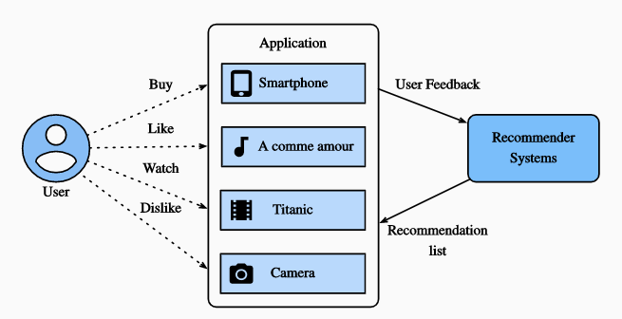
Introduction
Recommendation system(RS) can automatically recommend items to users by using historical records of their behavior and potential personal data.
Fig. 1 Illustration of the Recommendation Process [1]
※ [1] Book: Dive into Deep Learning
Notes:
Big data fascinates researchers in academia and industry since its enormous value in research and e-commerce.
information filtering systems are used greatly by people to retrieve information for improving their operational efficiency as people have enabled to passively obtain all kinds of information.

Slide 4
Recommendation System Categories
RS
Collaborative Filtering
User-based
Item-based
Content Based
Hybrid approach

Slide 5
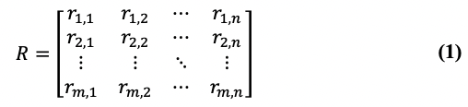
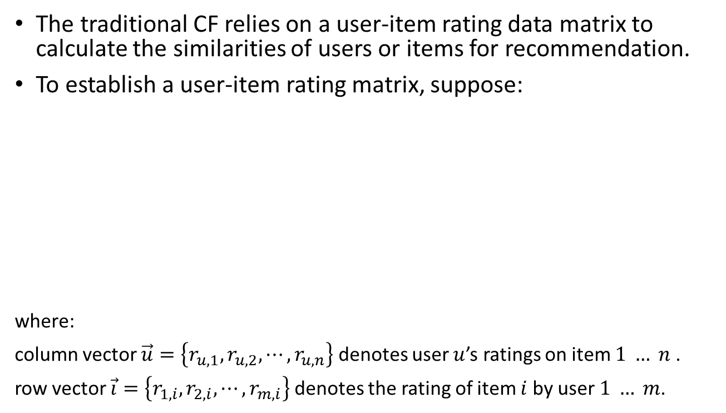
Collaborative Filtering Using Rating Matrix
The traditional CF relies on a user-item rating data matrix to calculate the similarities of users or items for recommendation.
To establish a user-item rating matrix, suppose:
where:
column vector $\vec{u}=\left\{r_{u,1}, r_{u,2}, ⋯, r_{u,n}\right\}$ denotes user $u$’s ratings on item $1 … n$ .
row vector $\vec{i}=\left\{r_{1,i}, r_{2,i}, ⋯, r_{m,i}\right\}$ denotes the rating of item $i$ by user $1 … m$.
 | Item 1 | Item 2 | … | Item n
User 1 | r1,1 | r1,2 | … | r1,n
User 2 | r2,1 | r2,2 | … | r2,n
… | … | … | … | …
User m | rm,1 | rm,2 | … | rm,n

Slide 6
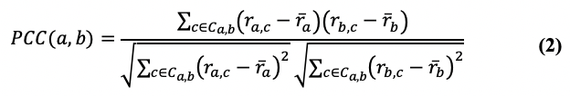
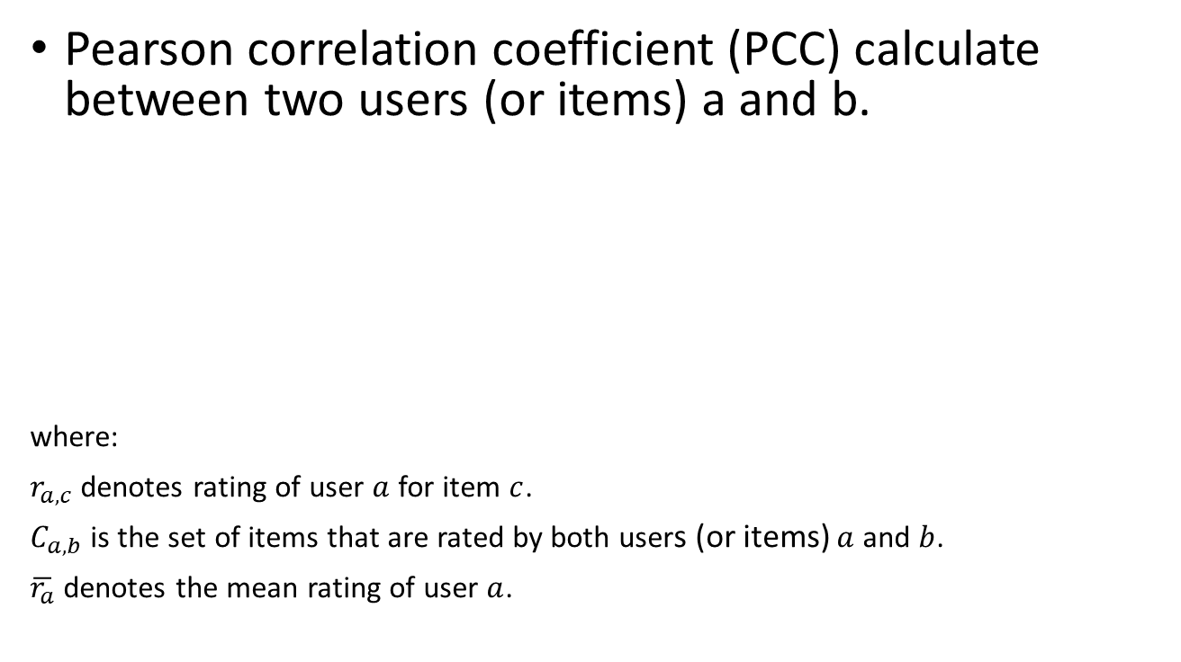
How can we measure similarity?
Pearson correlation coefficient (PCC) calculate between two users (or items) a and b.
where:
$r_{a,c}$ denotes rating of user $a$ for item $c$.
$C_{a,b}$ is the set of items that are rated by both users (or items) $a$ and $b$.
$\overline{r_{a}}$ denotes the mean rating of user $a$.
…
 | Item 1 | Item 2 | … | Item n
User 1 | r1,1 | r1,2 | … | r1,n
User 2 | r2,1 | r2,2 | … | r2,n
… | … | … | … | …
User m | rm,1 | rm,2 | … | rm,n
…
Notes:
The similarity between user a and user b can be calculated as (2):

Slide 7

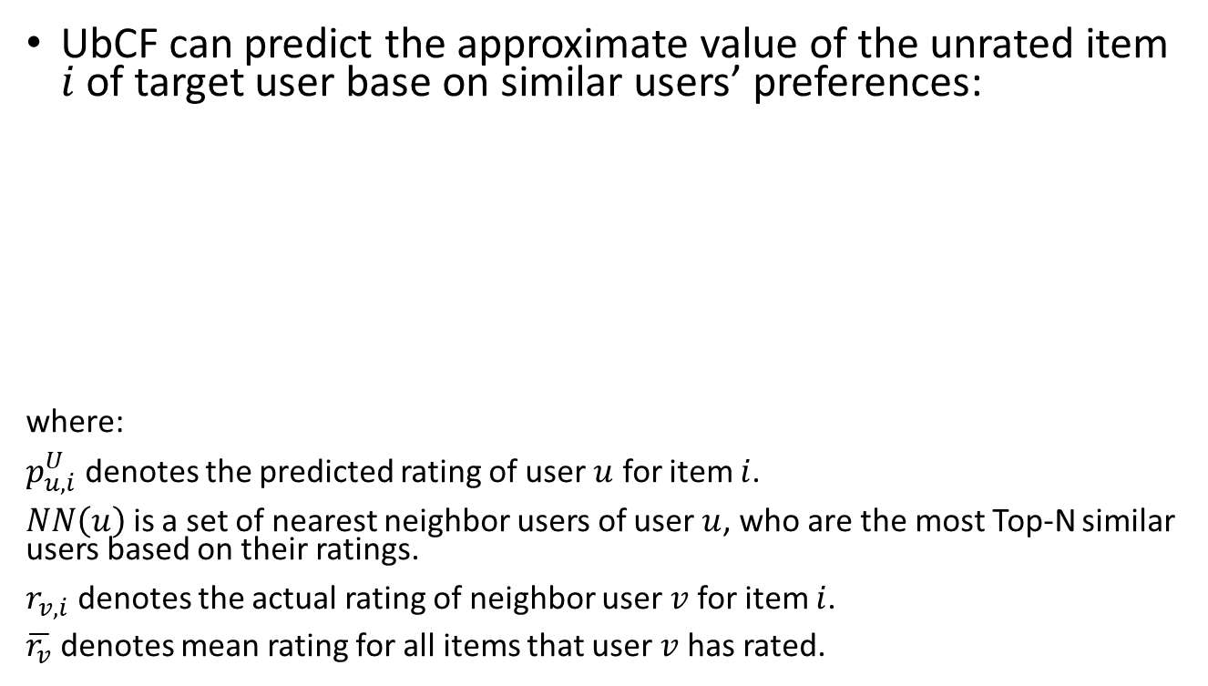
User-based Collaborative Filtering
UbCF can predict the approximate value of the unrated item $i$ of target user base on similar users’ preferences:
where:
$p_{u,i}^{U}$ denotes the predicted rating of user $u$ for item $i$.
$NN\left(u\right)$ is a set of nearest neighbor users of user $u$, who are the most Top-N similar users based on their ratings.
$r_{v,i}$ denotes the actual rating of neighbor user $v$ for item $i$.
$\overline{r_{v}}$ denotes mean rating for all items that user $v$ has rated.
 | i1 | i2 | i3 | i4 | i5
u1 | o | o | o |  | o
u2 | o | o | o |  | u
u3 |  | o
u4 |  |  | u | o | o
u5 |  |  | o | u | o
o denotes the item has been rated by user
u denotes UbCF prediction
Notes:
To predict the ratings, the traditional CF has involved the k-NN algorithm to obtain an ordered nearest neighbour set of target user or target item.
Then recommends the favourite items or mutual users of k numbers most similar neighbours from the target user or target item.

Slide 8


Item-based Collaborative Filtering
IbCF can also predict the approximate value of the unrated item $i$ of target user, but base on similar items’ features:
where:
$p_{u,i}^{I}$ denotes the predicted rating of item $i$ from user $u$.
$NN\left(i\right)$ is a set of nearest neighbor items of item $i$.
$r_{u,j}$ denotes the actual rating of neighbor item $j$ for user $u$.
$r_{j}$ denotes actual mean rating of user $u$.
 | i1 | i2 | i3 | i4 | i5
u1 | o | o | o |  | o
u2 | o | o | o |  | i
u3 | i | o | i
u4 |  |  | i | o | o
u5 |  |  | o |  | o
o denotes the item has been rated by user
i denotes IbCF prediction
Notes:
But, as the number of products or users on the site increases exponentially, the variability of items will affect the similarity index and ultimately reduce the accuracy of item recommendations[8].
Compared with UbCF, IbCF can significantly improve the scalability of CF and provide better quality[9]–[11].

Slide 9
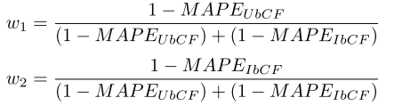

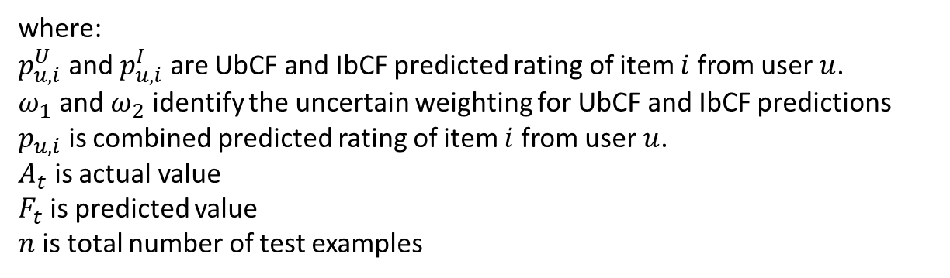
Collaborative Filtering Hybrid Approach
Combining UbCF and IbCF with a weighted-average Mean Absolute Percentage Error (MAPE).
For a huge data set, too much processing time.
where:
$p_{u,i}^{U}$ and $p_{u,i}^{I}$ are UbCF and IbCF predicted rating of item $i$ from user $u$.
$ω_{1}$ and $ω_{2}$ identify the uncertain weighting for UbCF and IbCF predictions
$p_{u,i}$ is combined predicted rating of item $i$ from user $u$.
$A_{t}$ is actual value
$F_{t}$is predicted value
$n$is total number of test examples

Slide 10
Combining UbCF and IbCF
UbCF
IbCF
 | i1 | i2 | i3 | i4 | i5
u1 | o | o | o |  | o
u2 | o | o | o |  | u
u3 |  | o
u4 |  |  | u | o | o
u5 |  |  | o | u | o
 | i1 | i2 | i3 | i4 | i5
u1 | o | o | o |  | o
u2 | o | o | o |  | i
u3 | i | o | i
u4 |  |  | i | o | o
u5 |  |  | o |  | o
 | i1 | i2 | i3 | i4 | i5
u1 | o | o | o |  | o
u2 | o | o | o |  | u/i
u3 | i | o | i
u4 |  |  | u/i | o | o
u5 |  |  | o | u | o
o denotes the item has been rated by user
u denotes UbCF prediction
i denotes IbCF prediction

Slide 11
Collaborative Filtering Improvements
Apply K-means algorithm to reduce the calculation time of CF.
Use Canopy Clustering to provide initial cluster number for K-means.
Canopy algo.
K-means algo.
Huge matrix

Slide 12



Proposed Approach
Start
Raw data
Rating matrix
Canopy clustering for user rating
Canopy clustering for item rating
This paper introduces a weighting approach that minimizes by the Root-mean-square Error (RMSE) for enhancing combination with UbCF and IbCF based on Canopy–K-means Clustering.
Canopy–K-means based Combined Collaborative Filtering (CKComCF)
Dynamic weight is the key to get better prediction results.
It can reduce the data sparsity load and improve the prediction accuracy.
K-means clustering for user
K-means clustering for item
no
Stable centroid ?
Stable centroid ?
no
yes
yes
User – PCC in each cluster
Item – PCC in each cluster
Top N neighbor
Top N neighbor
CF (mean center)
CF (mean center)
RMSE($R^{U}$) calculation
RMSE ${(R}^{I}$) calculation
$ω_{1}$ and $ω_{2}$ calculation
CKComCF
Evaluation
End

Slide 13
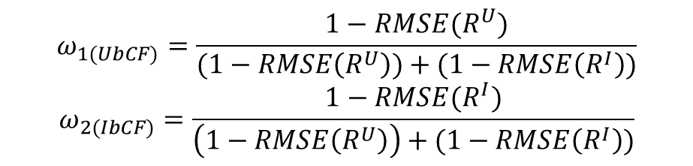

RMSE-minimization for ComCF
The weight between UbCF and IbCF can be obtained dynamically, thereby improving the system quality.
where:
$ω_{1}$ and $ω_{2}$ identify the weighted average as RMSE-minimization for combining UbCF and IbCF.
$R^{U}$denotes the set of rating for users .
$R^{I} is$the set of rating for items.
$$ω_{1(UbCF)}=\frac{1−RMSE(R^{U})}{(1−RMSE\left(R^{U}\right))+(1−RMSE\left(R^{I}\right))}$$
$$ω_{2(IbCF)}=\frac{1−RMSE(R^{I})}{\left(1−RMSE\left(R^{U}\right)\right)+(1−RMSE\left(R^{I}\right))}$$

Slide 14
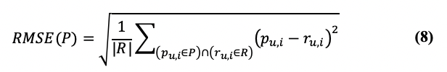
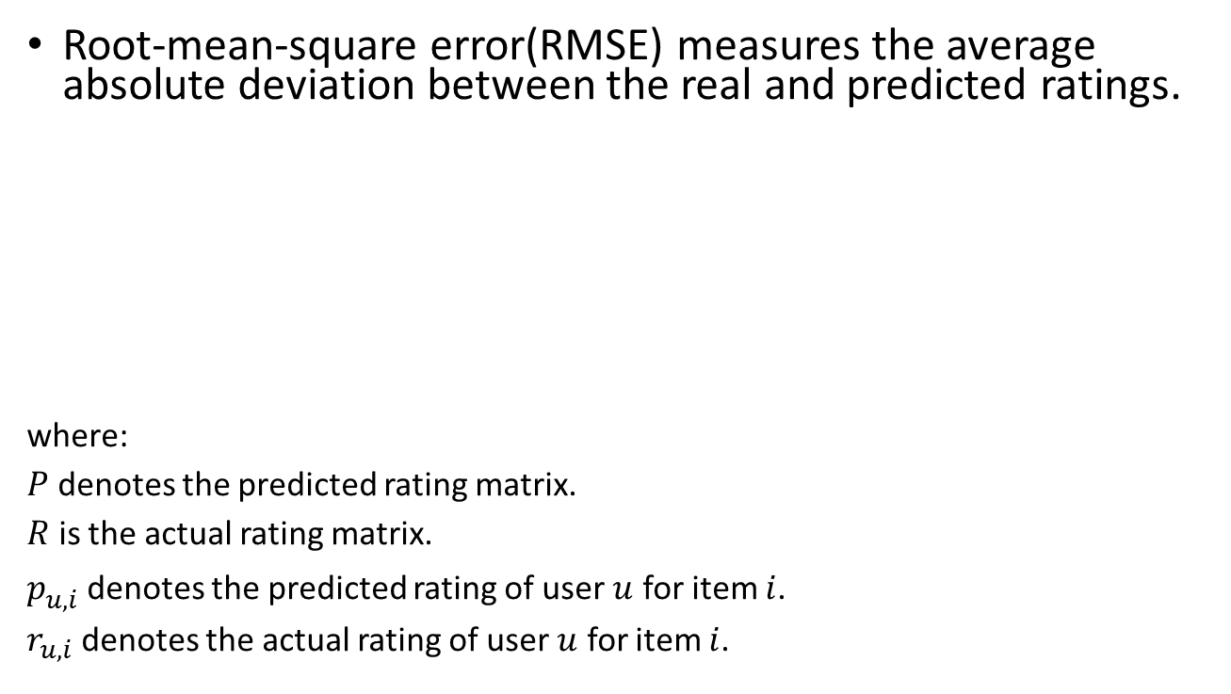
RMSE
Root-mean-square error(RMSE) measures the average absolute deviation between the real and predicted ratings.
where:
$P$ denotes the predicted rating matrix.
$R$ is the actual rating matrix.
$p_{u,i}^{}$denotes the predicted rating of user $u$ for item $i$.
$r_{u,i}$denotes the actual rating of user $u$ for item $i$.

Slide 15
Experiment
Dataset
MovieLens
Netflix Prize
Evaluation: RMSE
Result
Effectiveness of RMSE-minimization for ComCF
Effectiveness of CKComCF

Slide 16
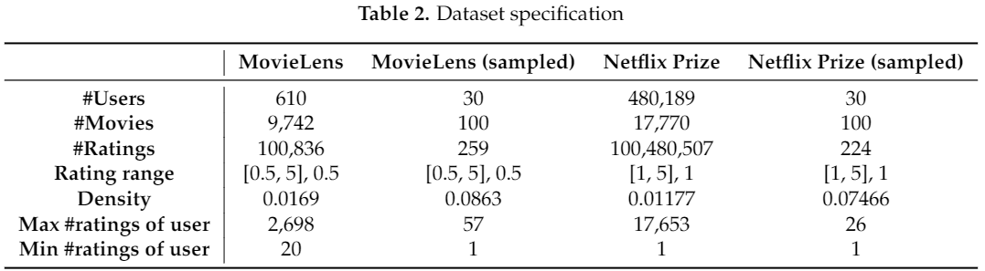
Dataset
Notes:
The experiments have been implemented on two widely used and well-known datasets including MovieLens [18] and Netflix Prize [19].
Besides, we randomly sampled based on the Gaussian distribution the data as 30 users on 100 items.

Slide 17
Result
Two experiments in MovieLens and Netflix Prize datasets:
Effectiveness of RMSE-minimization for ComCF
Effectiveness of CKComCF

Slide 18
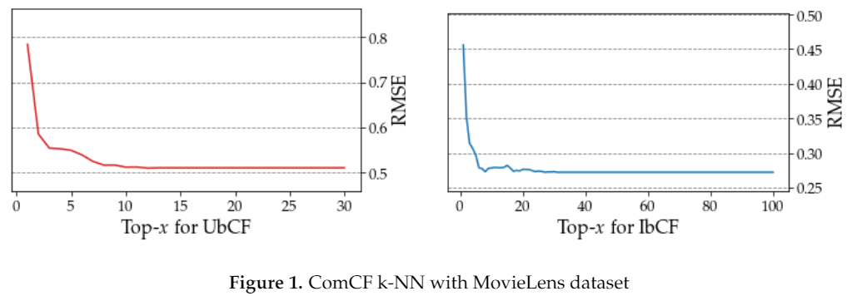
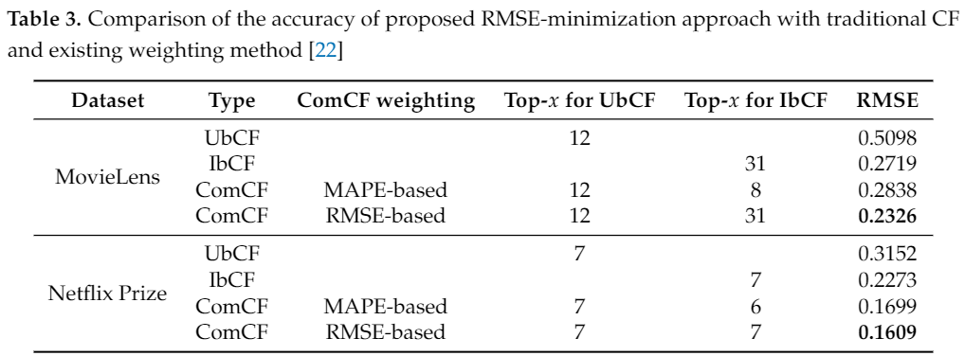
Effectiveness of RMSE-minimization for ComCF
In the examination of MovieLens dataset:

Slide 19
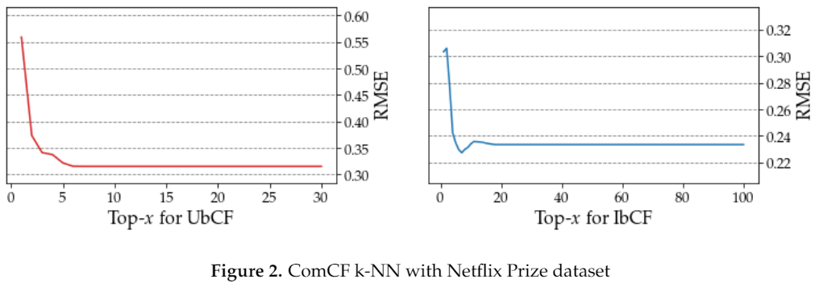
Effectiveness of RMSE-minimization for ComCF (Cont’d)
In the examination of Netflix Prize dataset:

Slide 20
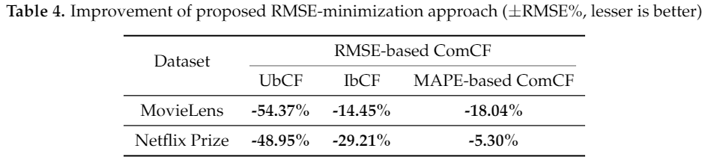
Effectiveness of RMSE-minimization for ComCF (Cont’d)

Slide 21
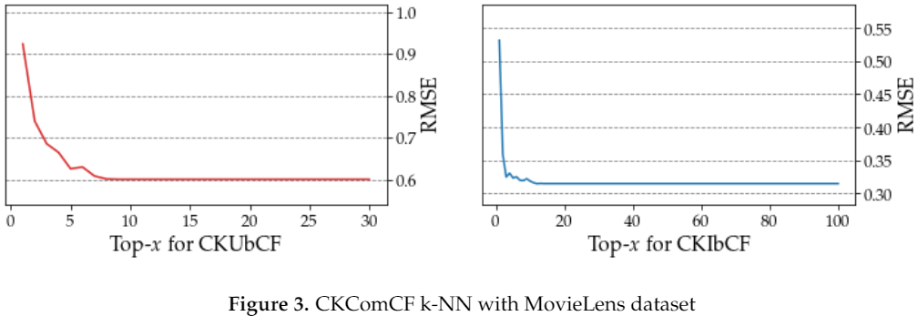
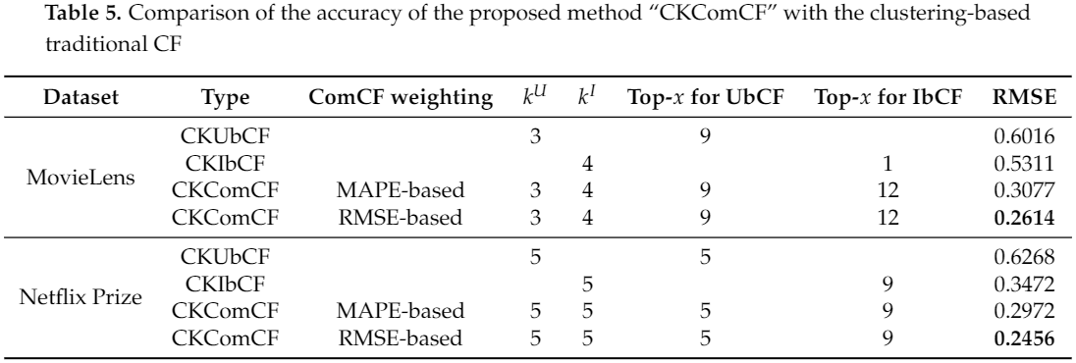
Effectiveness of CKComCF
For Canopy clustering, hyperparameter T1 and T2 are set as 0.3 and 0.2 respectively.
In MovieLens dataset:

Slide 22
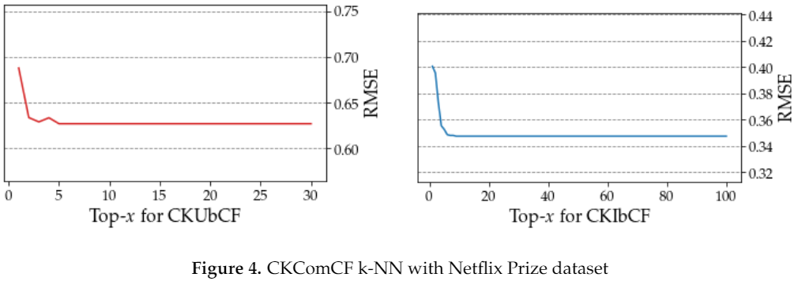
Effectiveness of CKComCF (Cont’d)
In Netflix Prize dataset:

Slide 23
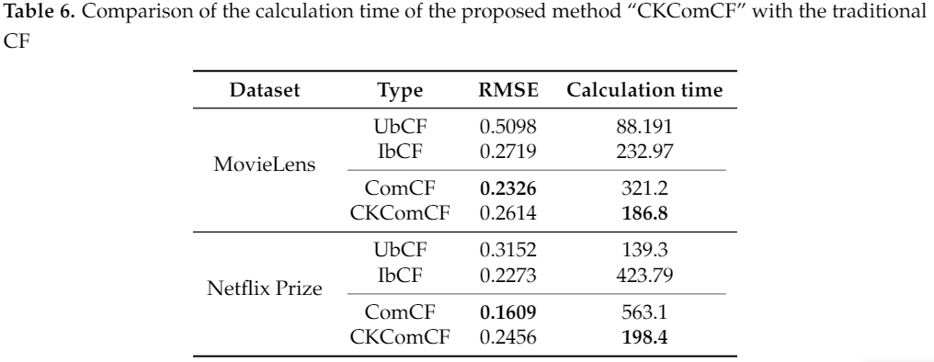
Effectiveness of CKComCF (Cont’d)

Slide 24
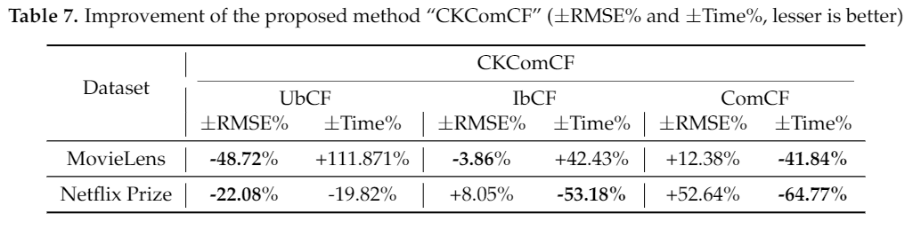
Result (Cont’d)
Notes:
The improvement of proposed CKComCF result is shown in Table 7. By comparing the ComCF and our approach(CKComCF), our approach does not improved the accuracy mainly, but hugely reduced the calculation time.
On the other hand, by comparing the traditional CF–UbCF and IbCF, although our approach not always improved the accuracy, accuracy stays fine generally.

Slide 25
Conclusion
A weighted RMSE-minimized model for ComCF is introduced.
CKComCF solved the scalability problem and retained the accuracy rate productively.
The experiments on real-world datasets with our approach and other algorithms for performance evaluation.
The results indicated that the proposed RMSE minimized method was effective.
Notes:
In this presentation, we introduced
Although Canopy--K-means did not guarantee the accuracy of predictions as the clusters were not optimal, the combination approach alleviated it.
Canopy-K-means and ComCF well complemented each other.
In the future, we will optimize the clustering function and consider changes in the preference changes in the of users and the long-tail effect of items on the system.

